Slide 1
Smoking Detection
Based on YOLOv11 Architecture
with Slicing Aided Hyper Inference
Group 15
Nguyen Quang Huy - 22BI13195
Nguyen Tuan Khai - 22BI13202
Le Linh Long - 22BI13262
Pham Thai Son - 22BI13397
NICOTINE
FREE

Slide 2
Table of Contents
01
03
02
04
Introduction
Experimental Analysis
Technical Framework
Conclusion

Slide 3
01
Introduction
NICOTINE
FREE

Slide 4
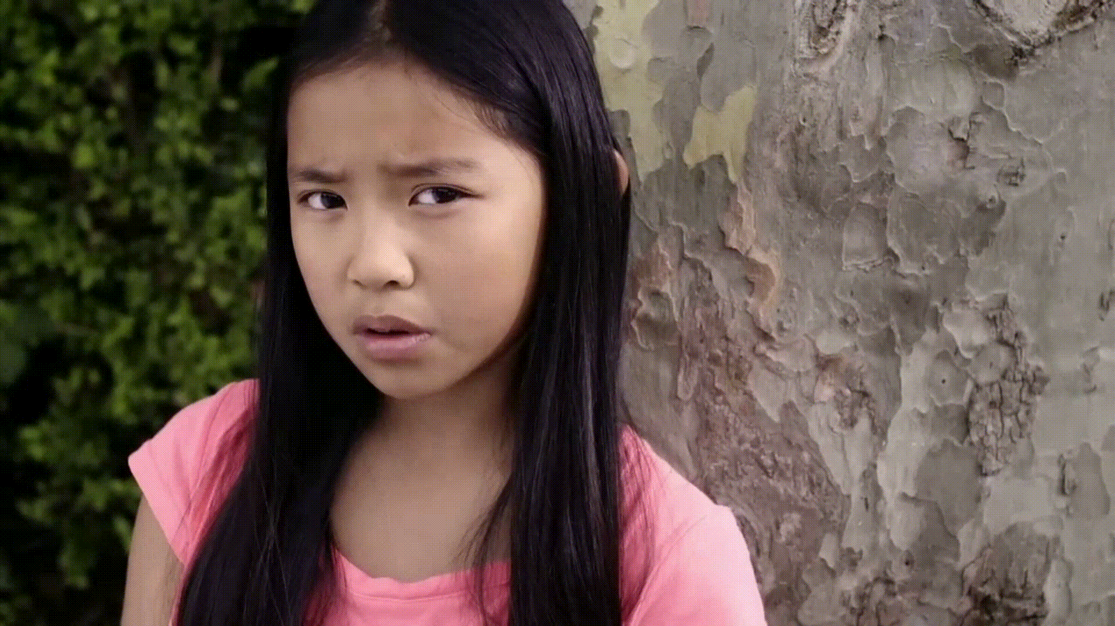
Motivation

Slide 5
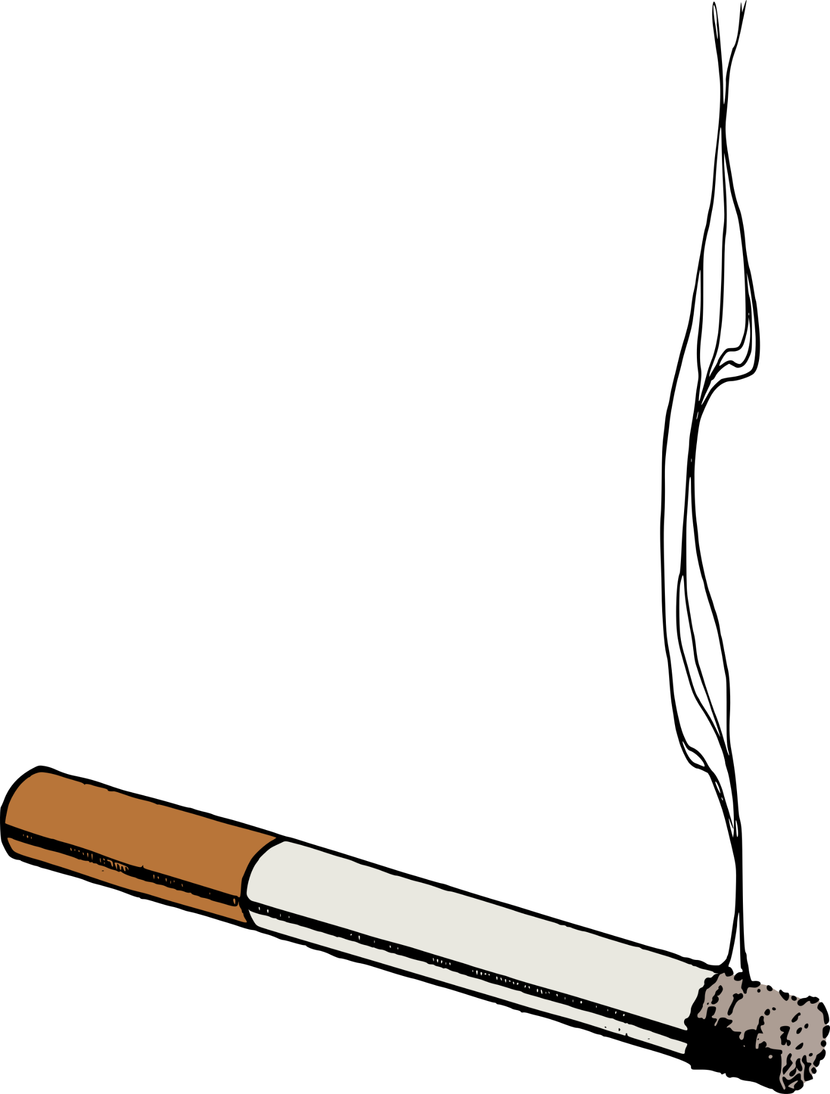
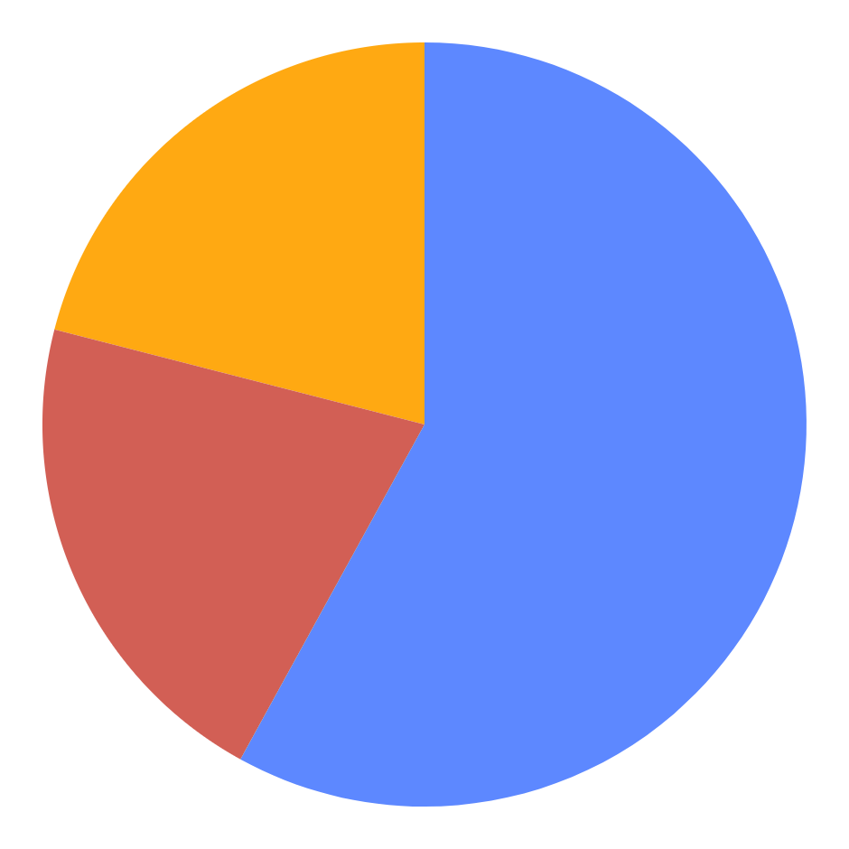
Dataset
64%
Train
18%
Valid
18%
Test
745 Images
207 Images
207 Images

Slide 6
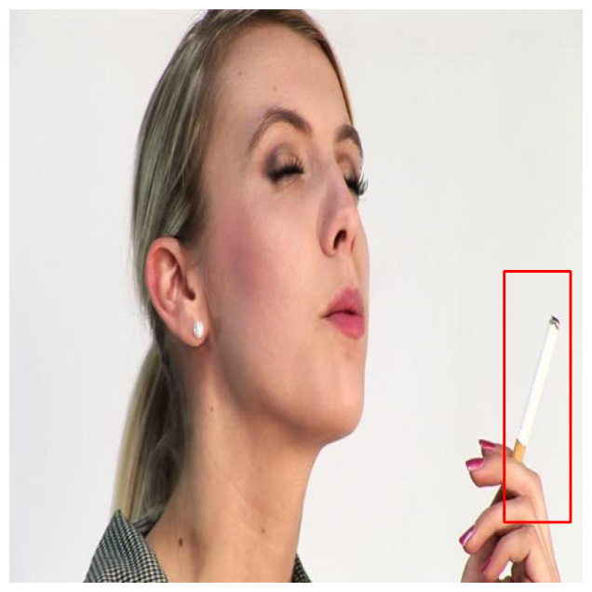
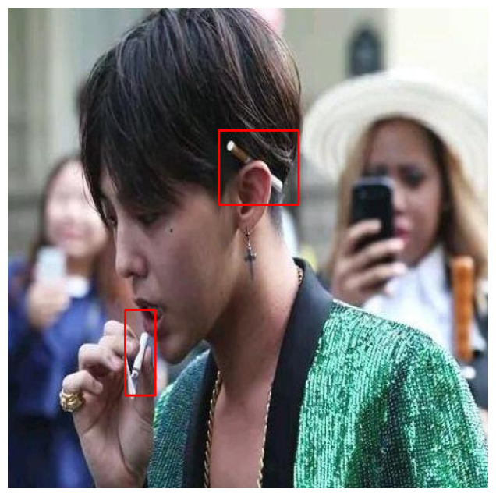
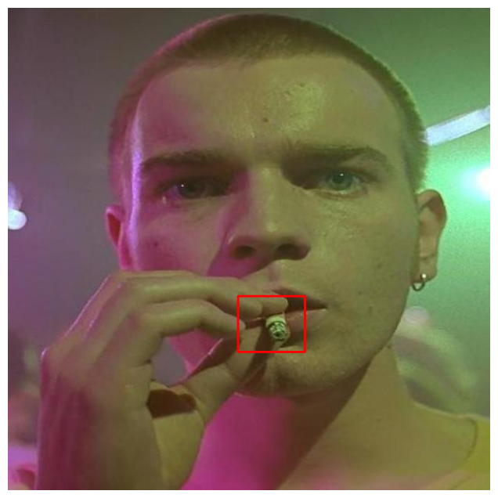
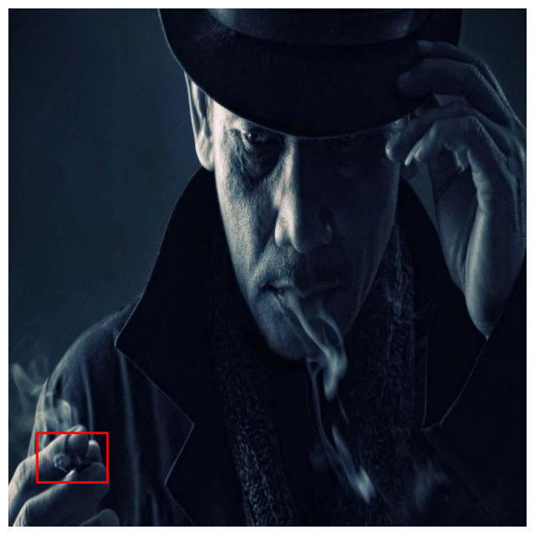
Image Examples
Illumination
Occlusion
Perspective / Occlusion
Combination

Slide 7
Image Examples
Illumination
Occlusion
Perspective / Occlusion
Combination

Slide 8
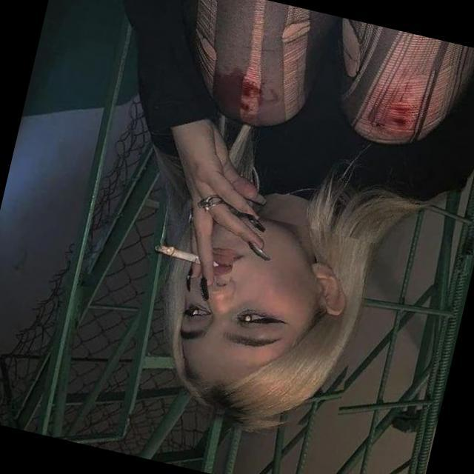
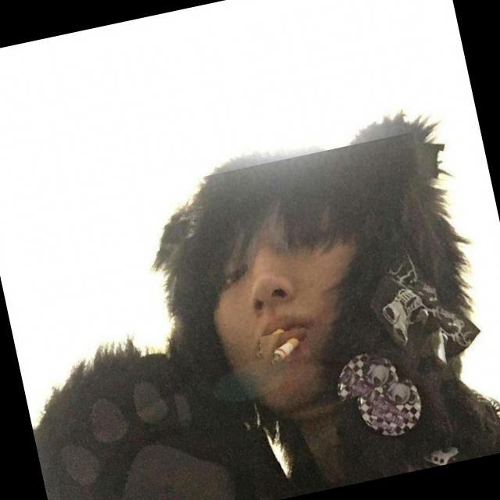
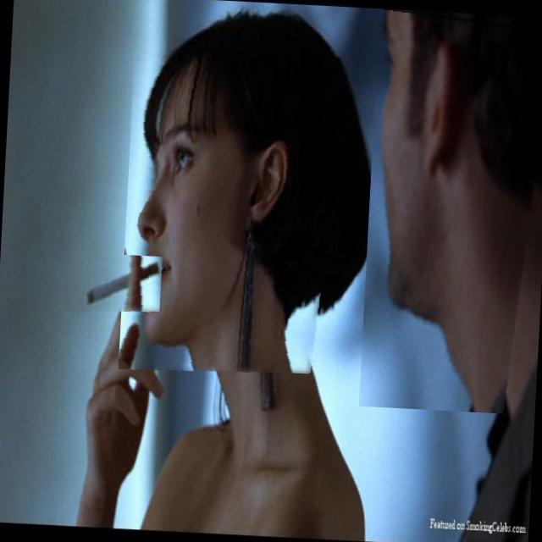
Data Augmentation
Random Rotation
Random Cropping
Vertical / Horizontal Flipping
Bounding Box Shear

Slide 9

02
Technical Framework

Slide 10
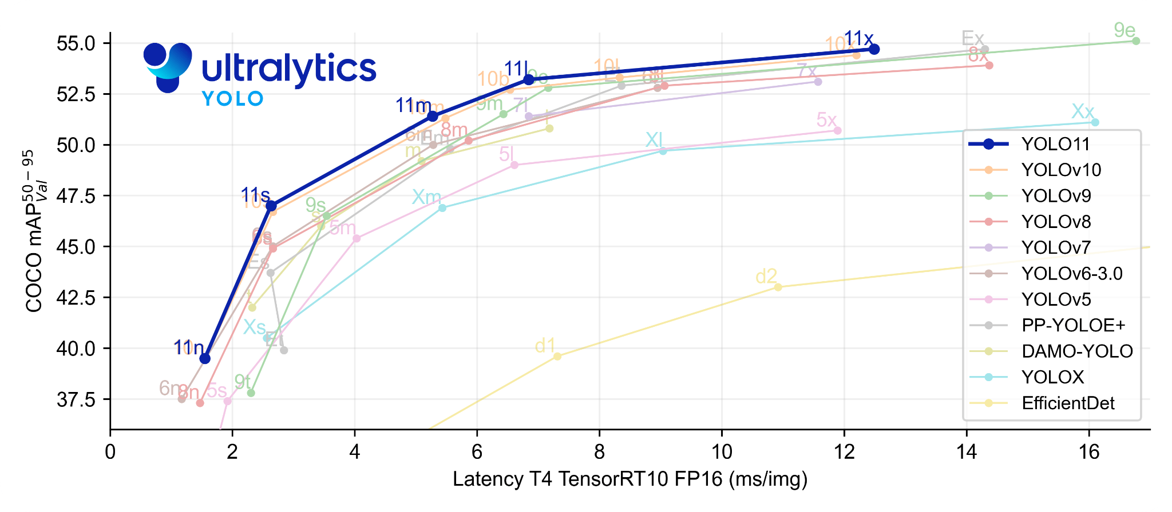
YOLOv11

Slide 11
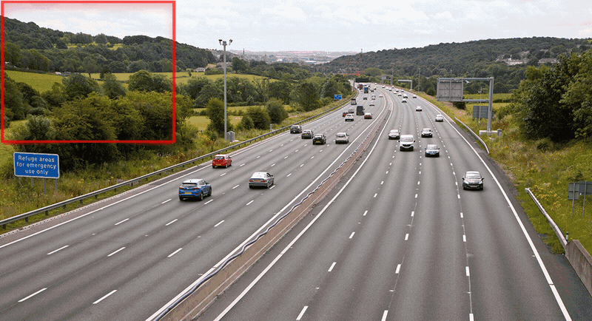
Slicing Aided Hyper Inference

Slide 12
03
Experimental
Analysis

Slide 13
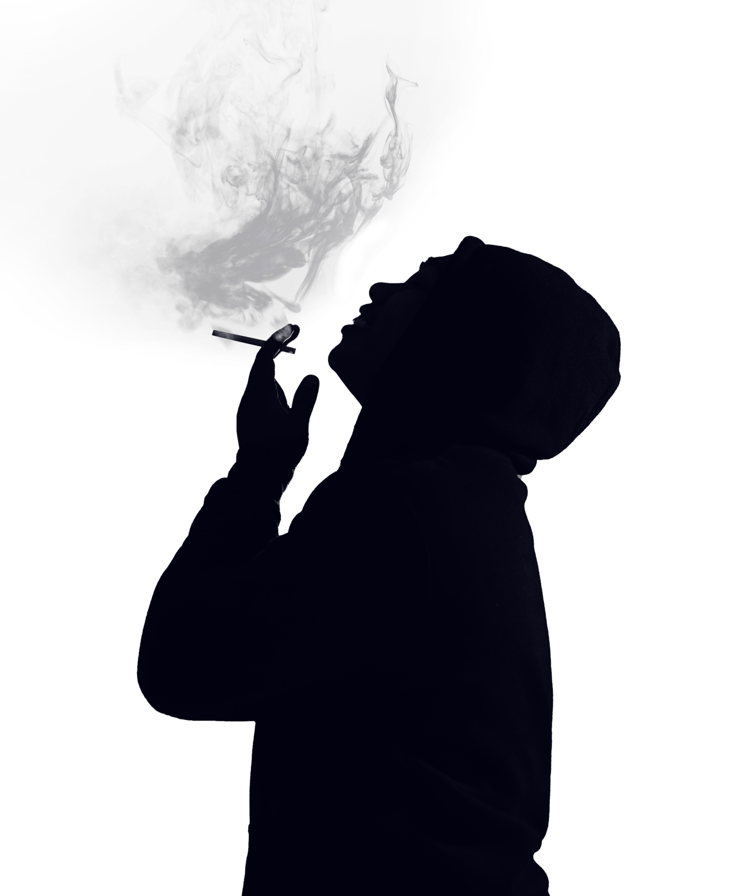
Hardware
OS | GPU | Programming Language | PyTorch
Windows 11 | NVIDIA GeForce RTX 3050 6GB | Python 3.11.9 | 2.5.1

Slide 14
Metrics
Accuracy-Based Metrics
Precision
2. Recall
Mean Average Precision
(mAP@50)
Efficiency-Based Metrics
Frames Per Second
2. Latency
3. Throughput

Slide 15
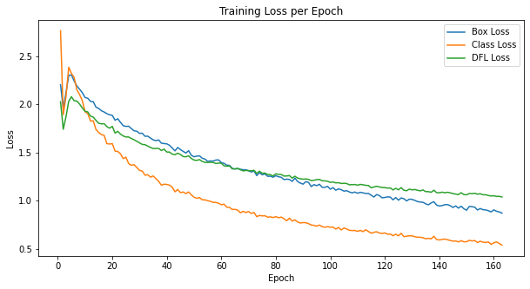
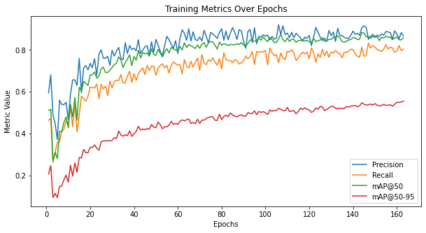
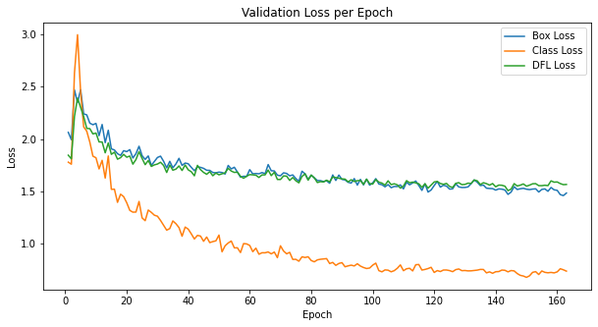
Results

Slide 16
Results

Slide 17
Results
Methods | Precision | Recall | mAP50
SmokeNet-SE [1] | -- | -- | 86.26%
YOLOv8-MNC [2] | -- | -- | 85.887%
Custom [3] | -- | -- | 86.32%
YOLOv11 | 90.1% | 90.1% | 90.1%
YOLOv11 + SAHI | 89.9% | 90.8% | 89.9%
[1]: K. Zhao, ”Real-Time Detection of Drivers’ Smoking Behavior Using the Improved YOLO-V4 Model”
[2]: Z. Wang, L. Lei, and P. Shi, ”Smoking Behavior Detection Algorithm Based on YOLOv8-MNC”
[3]: Z. Zhang, H. Chen, R. Xiao, and Q. Li, ”Research on Smoking Detection Based on Deep Learning”

Slide 18
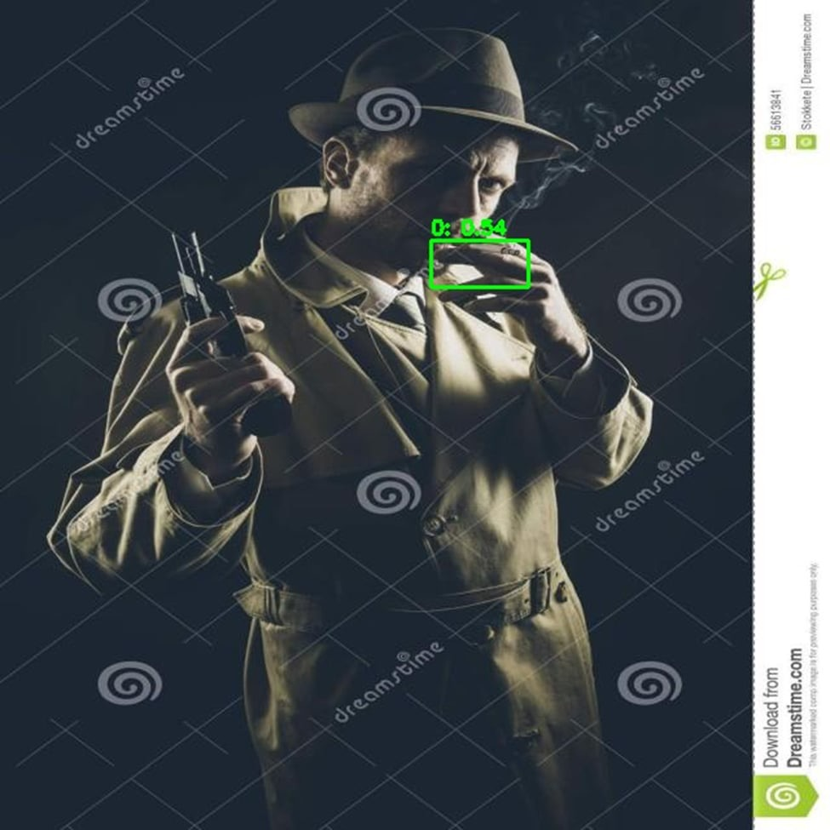
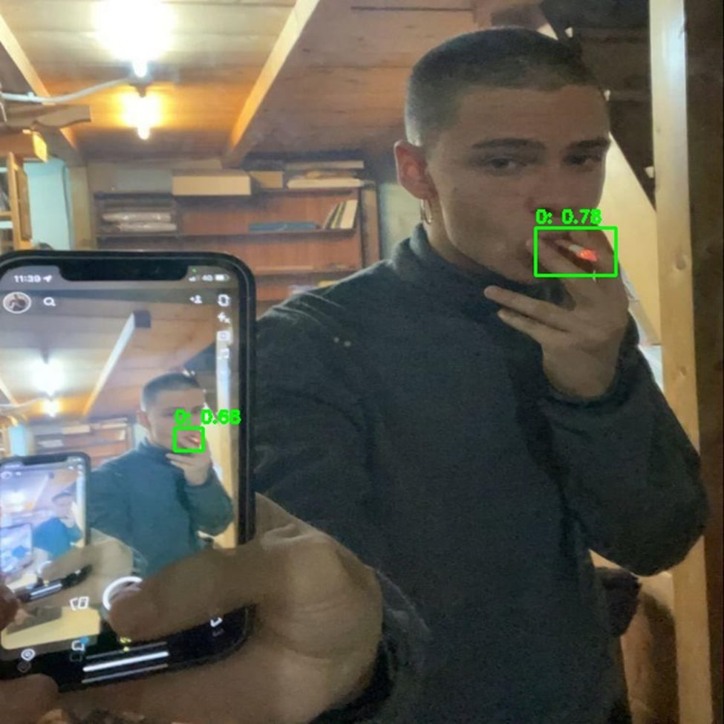
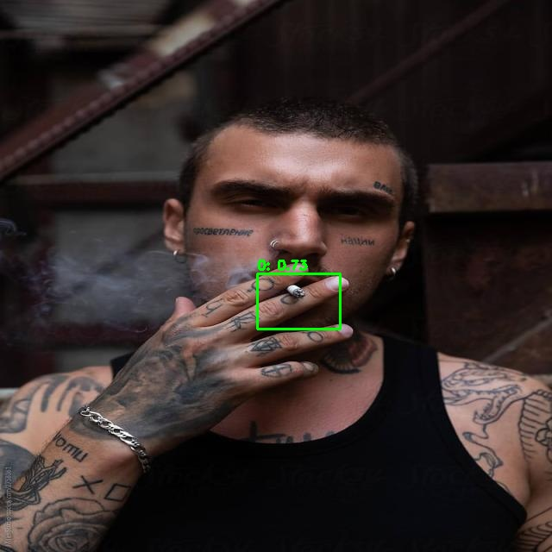
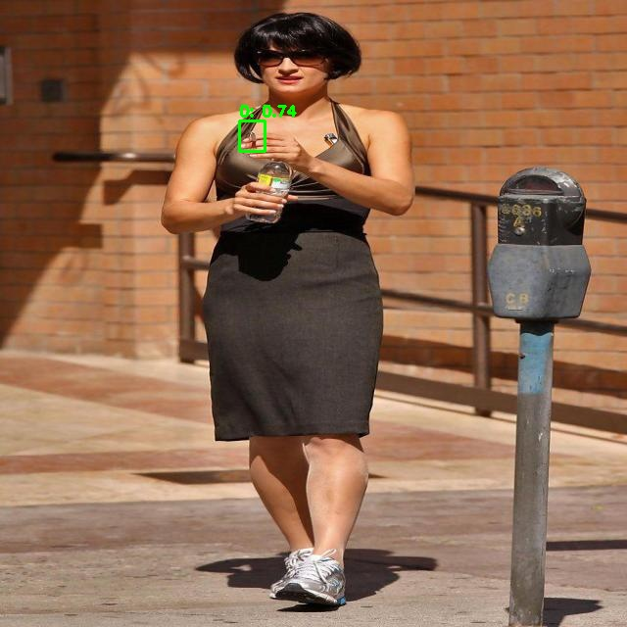
Sample Results
Illumination
Small Object
Perspective
Perspective + Occlusion + Size

Slide 19
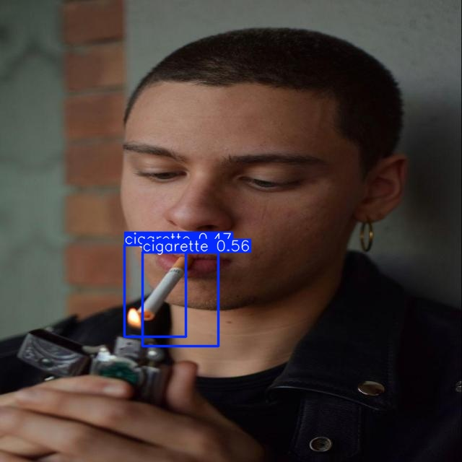
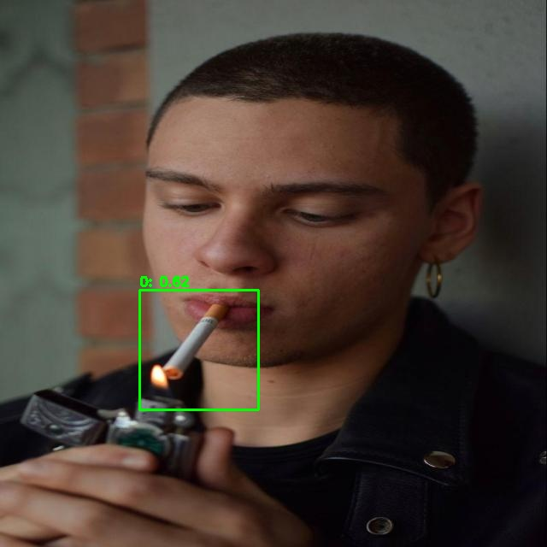
Sample Results
Illumination
Small Object
Perspective
Perspective + Occlusion + Size
Original YOLOv11
YOLOv11 with SAHI

Slide 20
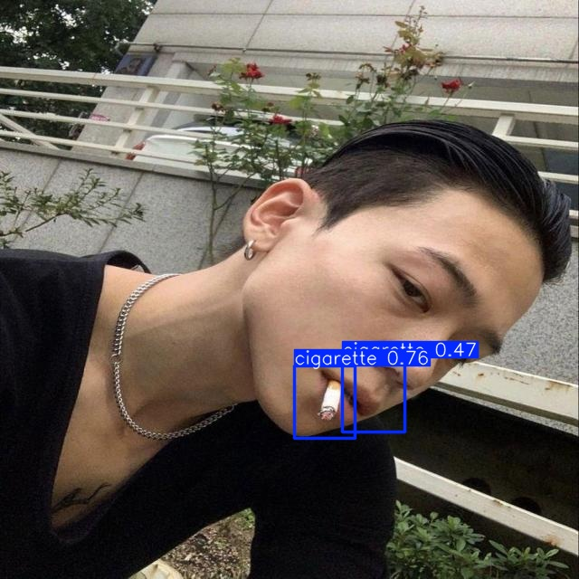
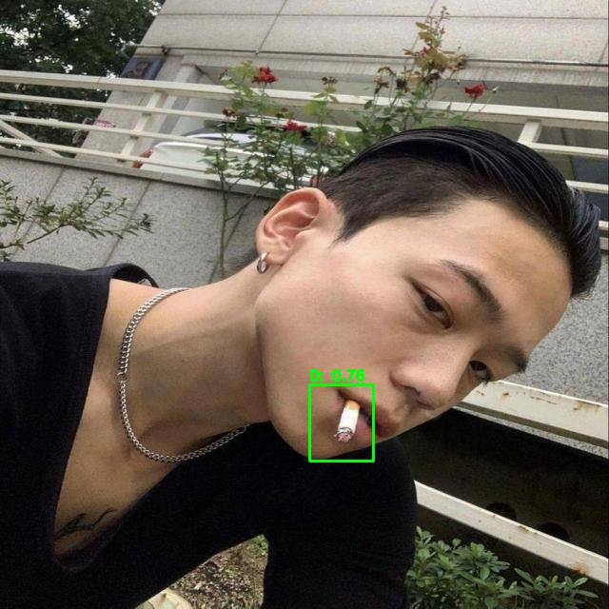
Sample Results
Perspective
Perspective + Occlusion + Size
Original YOLOv11
YOLOv11 with SAHI
Original YOLOv11
YOLOv11 with SAHI

Slide 21
Sample Results
Original YOLOv11
YOLOv11 with SAHI
Original YOLOv11
YOLOv11 with SAHI

Slide 22
Results
Metrics | YOLOv11 | YOLOv11 + SAHI
FPS | 13.23 | 5.26
Latency per Images | 205.16 ms | 175.32 ms
Throughput | 18.41 Img/s | 5.21 Img/s

Slide 23
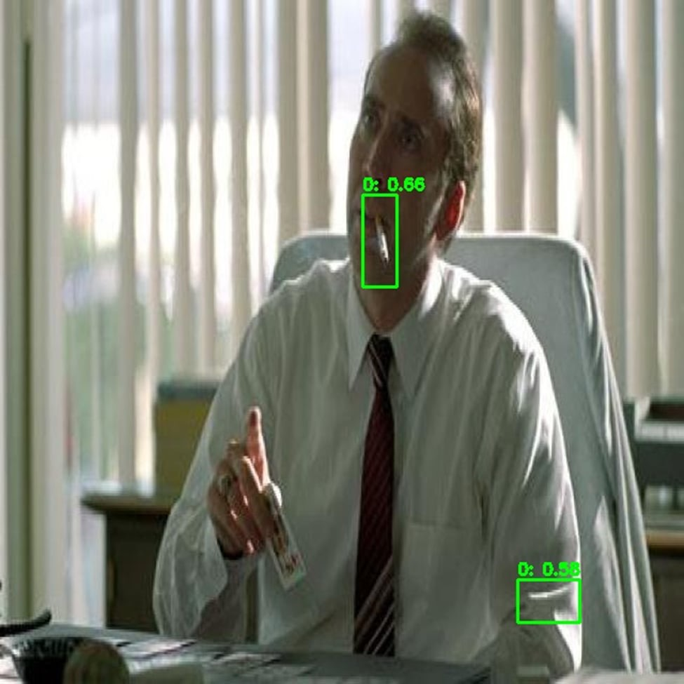
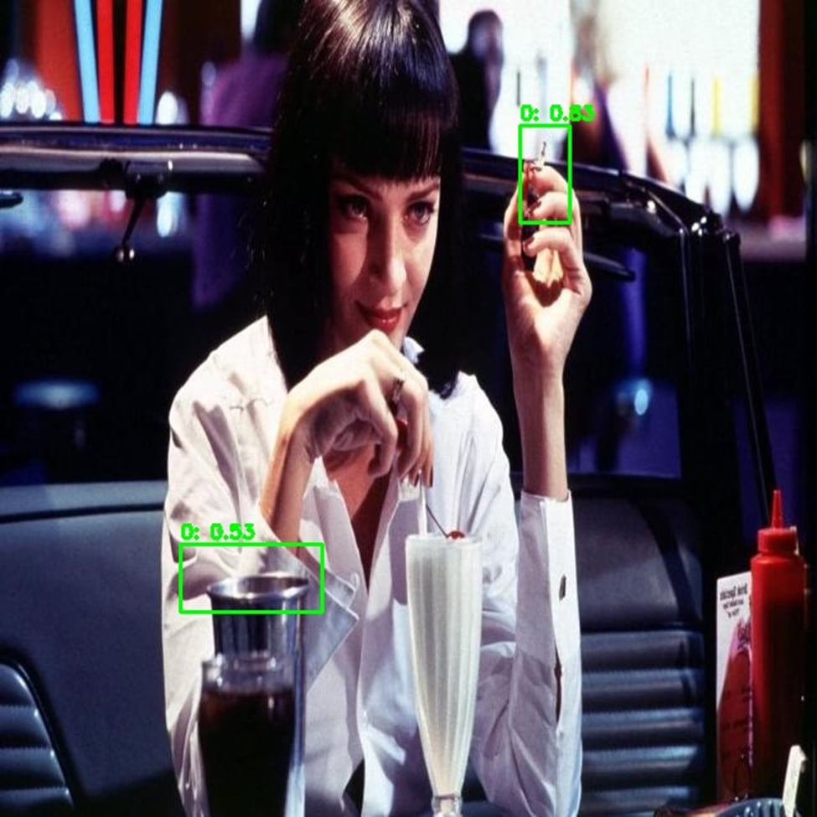
Challenges
False Positive

Slide 24
04
Conclusion

Slide 25

Thanks!

